Slide 1
Test Yourself online quiz website
Challenge your self
Name:
Prathamesh Balasaheb Dehade
Shaad
Roll no:

Slide 2
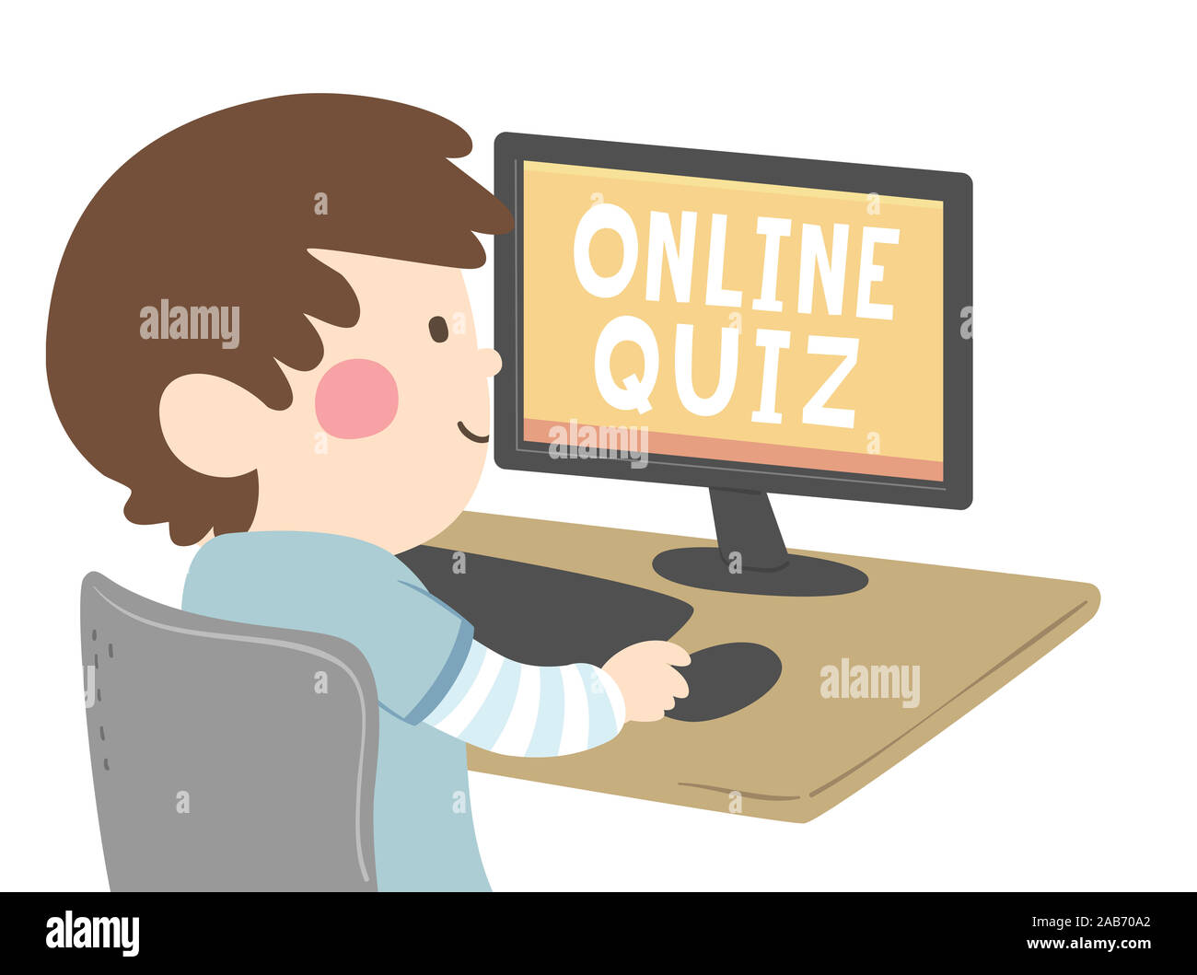
Introduction
“Interactive online quiz website.”
“Helps users practice and Designed for all age groups:
Kids, Teens, Adults.
” knowledge in different subjects.”

Slide 3
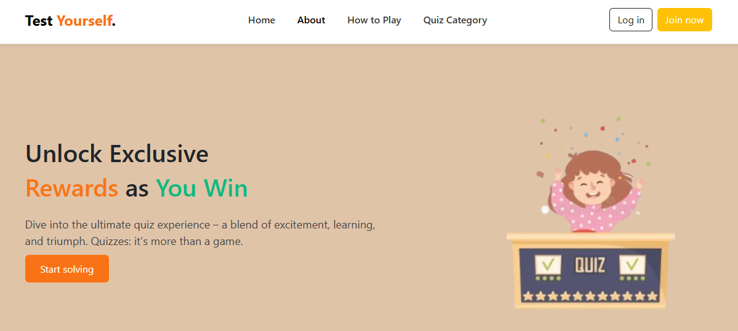
Home Page
Landing page for the website
Options to Login or egister
Welcoming interface for users to quizzes.
Navbar: Home , About, How to plat , Quiz Category, Login, Registeration

Slide 4
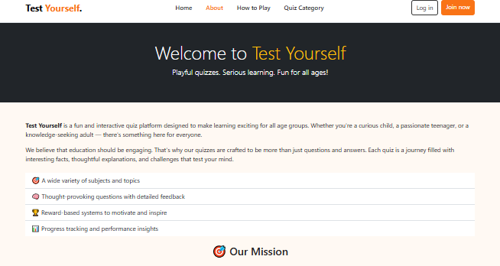
About Page
Test Yourself is an interactive quiz website.
Designed to help users practice, learn, and test knowledge.
Offers multiple subjects and age-based categories.
Simple, engaging, and user-friendly interface.

Slide 5
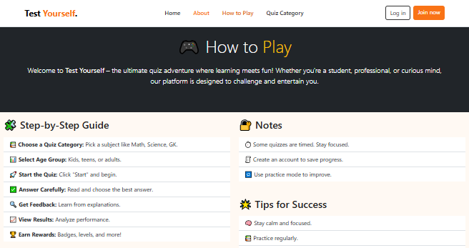
How to play Page
Login/Register to get started.
Choose your Age Category (Kids, Teens, Adults).
Select a Subject (Math, Science, GK, etc.).
Read the Instructions carefully.
Start the Quiz – 20 Questions, 3 questions per page.
Complete within 2 minutes (timer runs on screen).
Submit & View Score with options to Retry or Return to Main Menu.

Slide 6
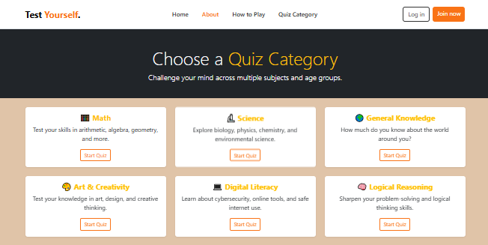
Age Category Page
Users select their age group before starting the quiz.
Categories ensure questions are age-appropriate.
Example categories:
  👶 Kids (8–12 years)
  🧒 Teens (13–18 years)
  👩‍🎓 Adults (18+ years)
Makes the quiz personalized and fair.

Slide 7
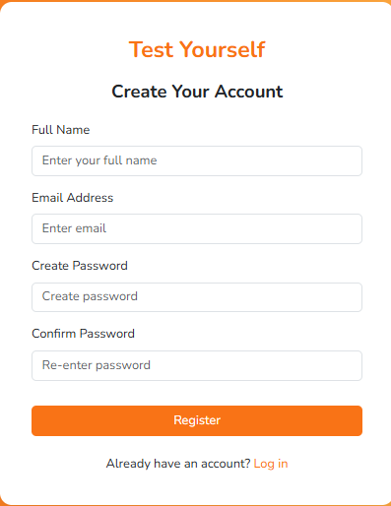
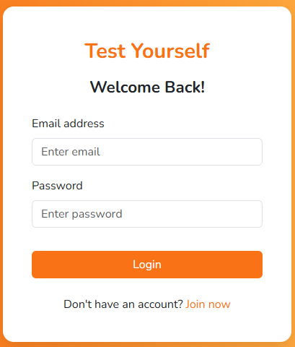
Login & Registration
Users Create a new account or login to continue.
Secure and easy-to-use forms.
Ensures personalized quiz experience.
Registration Page
Login page

Slide 8
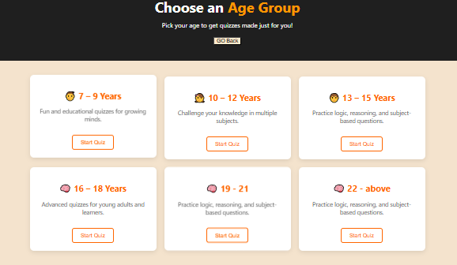
Age Group Selection
Users select their age group before starting the quiz.
Categories ensure questions are age-appropriate.
Example categories:
7 – 9 Years 10 – 12 Year 13 – 15 Years 16 – 18 Years
19 – 21 Years 22- Above
Makes the quiz personalized and fair

Slide 9
Features
Title: Key Features of Test Yourself Quiz Website
Content:
Test Yourself is designed to provide an engaging and interactive quiz experience for users of all ages. Its main features include:
Age-based categories ensure questions are suitable for all users.
Multiple subjects like Math, Science, and General Knowledge.
Timed quizzes with a 2-minute countdown for all 20 questions.
Three questions displayed per page for easy navigation.
Users can move back and forth between pages to review answers.
Instant score calculation after quiz submission.
Retry option allows users to attempt the quiz again.
Simple, user-friendly, and engaging interface for all ages.

Slide 10
Data Flow
Step-by-Step Quiz Flow
Content:
The quiz website follows a smooth and intuitive workflow designed to guide the user from start to finish
Users start at the Home Page with login, About, and How to Play options.
New users register; returning users log in.
Select age category: Kids, Teens, or Adults.
Choose a subject to attempt the quiz.
Instructions page shows quiz rules and timer
Quiz page displays 3 questions per page with a 2-minute timer.
Submit answers to see the score and percentage instantly.
Options to return to the main menu or retry the quiz.

Slide 11
.
.
Future Enhancement
Title: Future Enhancements for Test Yourself
Content :
The Test Yourself platform has been designed as a robust and interactive quiz website, but there is always room for improvement. Some of the potential future enhancements include:
Add more subjects to increase variety in quizzes.
Introduce difficulty levels: easy, medium, and hard.
Implement a leaderboard to track top scores.
Mobile-friendly design for smartphones and tablets
Allow users to track performance over time.
Include timed challenges for competitive quizzes.
Add multimedia questions with images or videos.
Enable social sharing of scores to motivate learning.

Slide 12
.
.
Thank You

